Slide 1
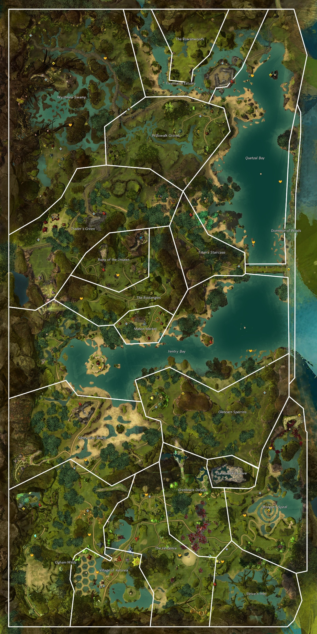
26
22
1-dream and wyldf hunt was disturbing, check on locals
2-pups seem to be fine, go check for with
3-undead filth, look for source of the undead
4-some of these corpses are nightmare court. There must be a hidden base nearby
5-more undead, keep checking northing
6-found a hidden entrance but cant get in. keep chjecking north
7-meet frogs, no mention of nightmare court, head west along shore to sherriff
8-talk to sheriff nora, look for a key to entrance
9-didn’t find key but found note about forces building in the bog. Head to mabon’s terrace to prep
10- Guard mentions Tovar going west to kill nightmare court
11-Tovar complains about the skritt stealing something the NC had and would like us to retrieve it
12-get through hidden door, was there anything in that chest worthwhile? I took this bloody thorn, nasty thing. Lets take it to trader’s green to report it in
13-you smell that in the air, what a putrid stench. Since we turned over the thorn, lets head north. Nothing good can come from that
14-the NC were trying to harness the power of the jungle worm?!? Outrageous. To have enough power todo that must mean their main base is around here somewhere
15-Good, we’ve found the entrance but still need to prepare a few things. While we do that, head north east and see if Zinder slope has been effected
25
23
21
24
20
18
17
16
19
15
14
9
10
11
12
13
8
7
6
2
3
4
1
5

Slide 2
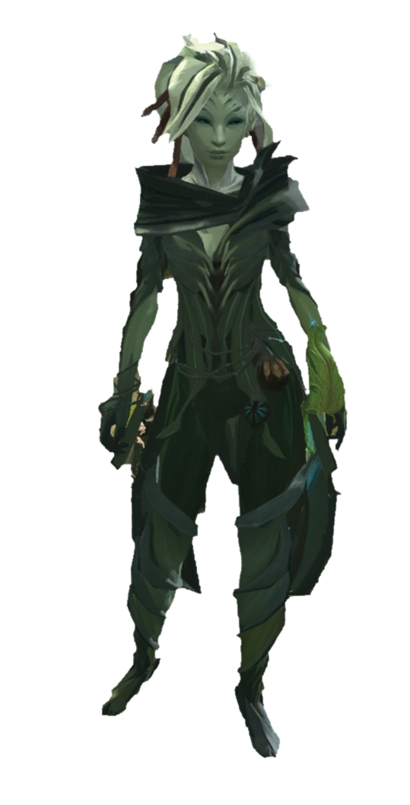

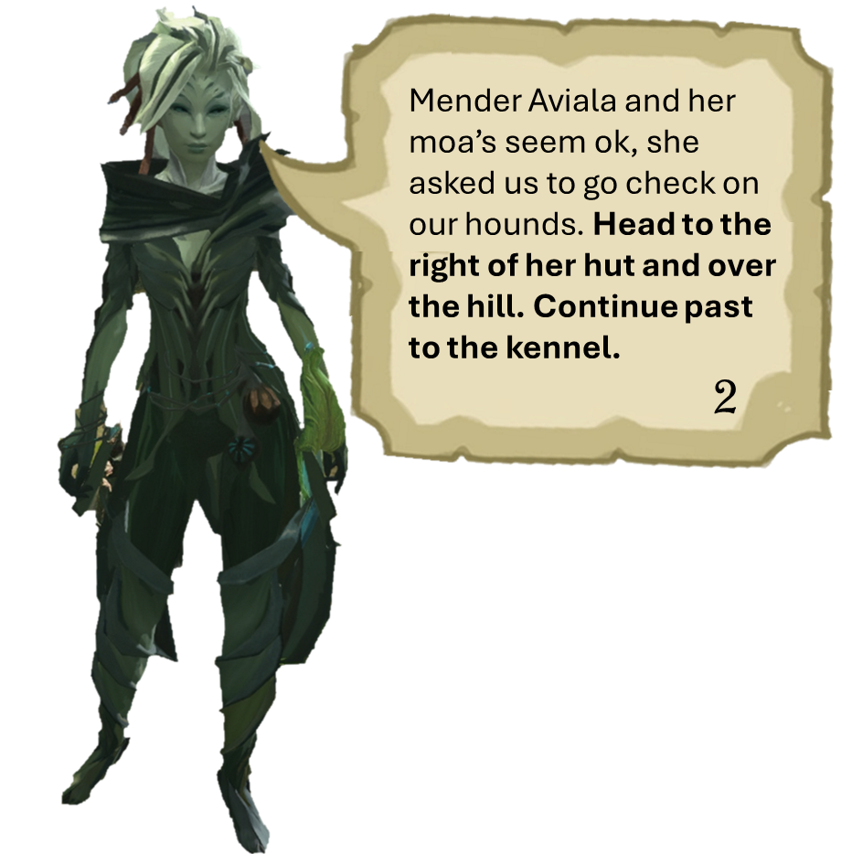
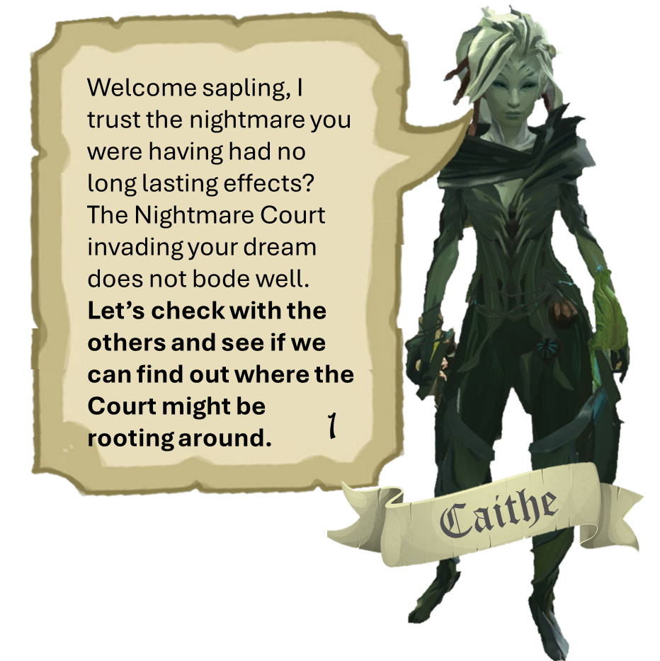
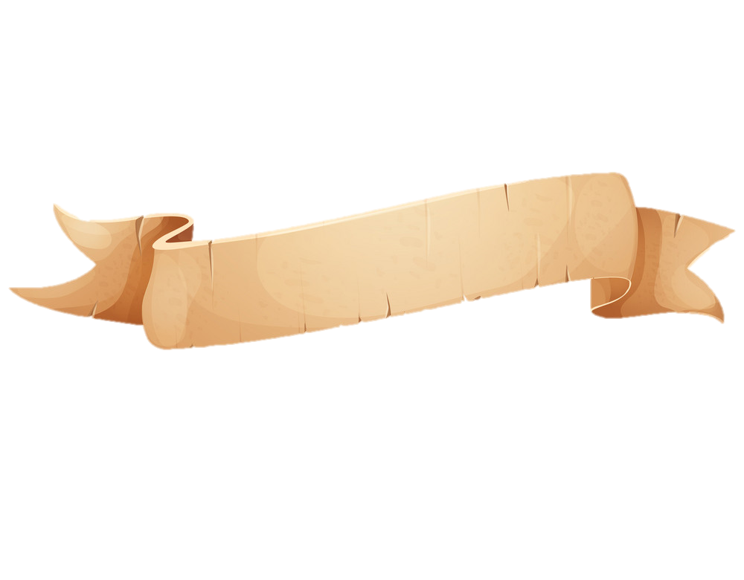
Mender Aviala and her moa’s seem ok, she asked us to go check on our hounds. Head to the right of her hut and over the hill. Continue past to the kennel.
Welcome sapling, I trust the nightmare you were having had no long lasting effects?
The Nightmare Court invading your dream does not bode well. Let’s check with the others and see if we can find out where the Court might be rooting around.
2
1
Caithe

Slide 3
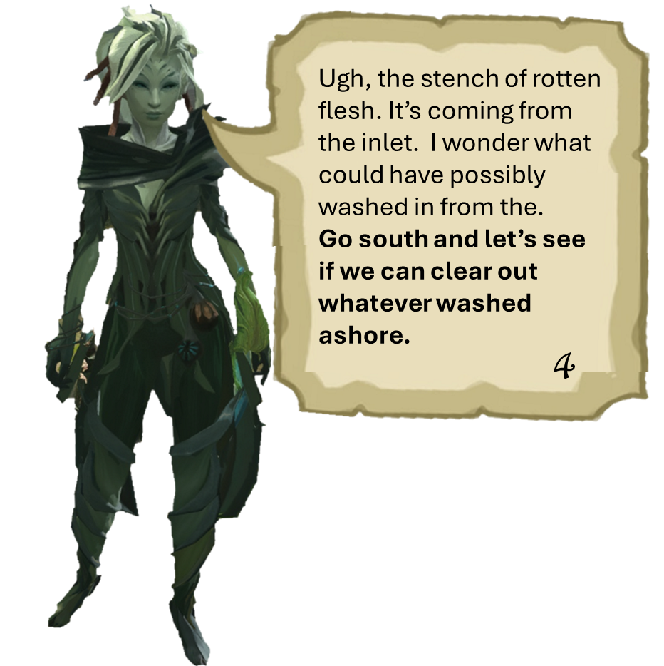
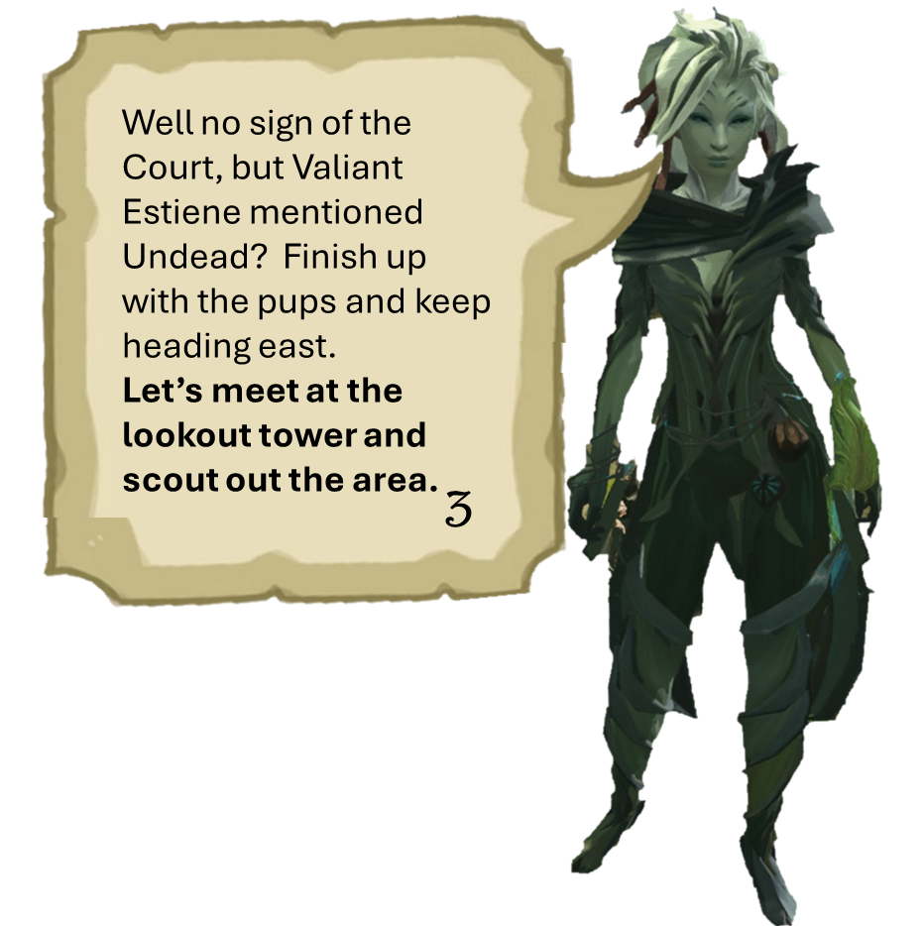
Ugh, the stench of rotten flesh. It’s coming from the inlet. I wonder what could have possibly washed in from the.
Go south and let’s see if we can clear out whatever washed ashore.
Well no sign of the Court, but Valiant Estiene mentioned Undead? Finish up with the pups and keep heading east.
Let’s meet at the lookout tower and scout out the area.
4
3

Slide 4
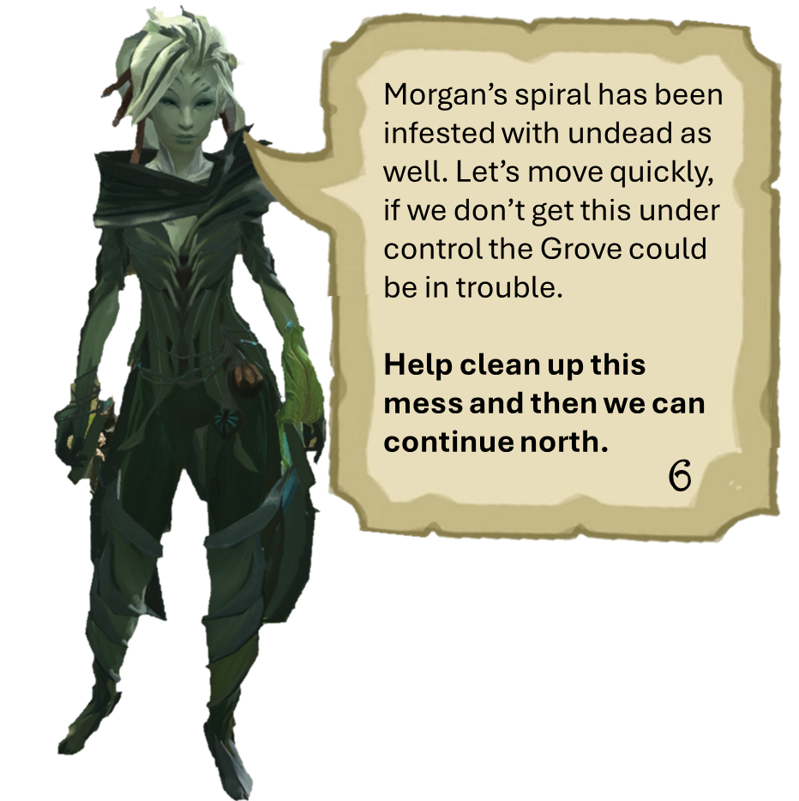
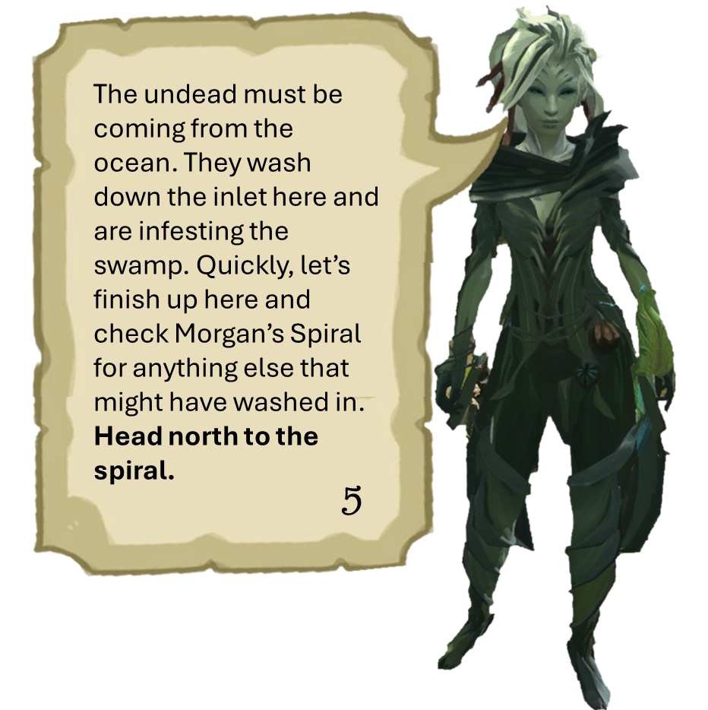
Morgan’s spiral has been infested with undead as well. Let’s move quickly, if we don’t get this under control the Grove could be in trouble.
Help clean up this mess and then we can continue north.
The undead must be coming from the ocean. They wash down the inlet here and are infesting the swamp. Quickly, let’s finish up here and check Morgan’s Spiral for anything else that might have washed in.
Head north to the spiral.
6
5

Slide 5
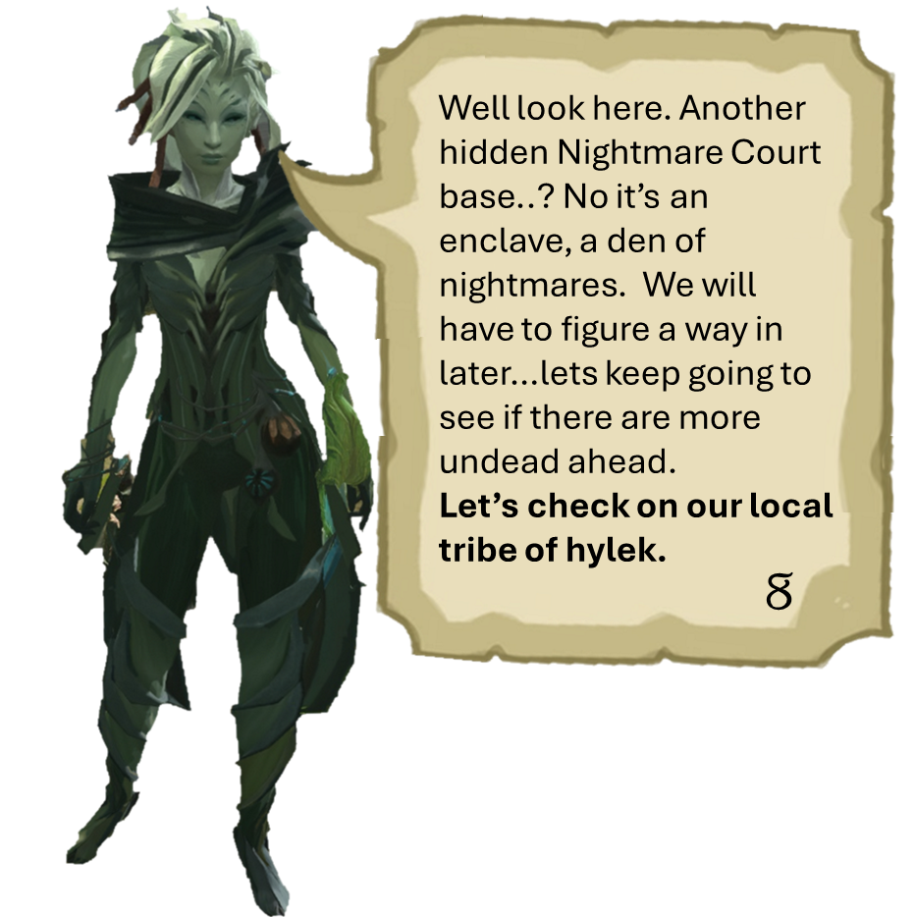
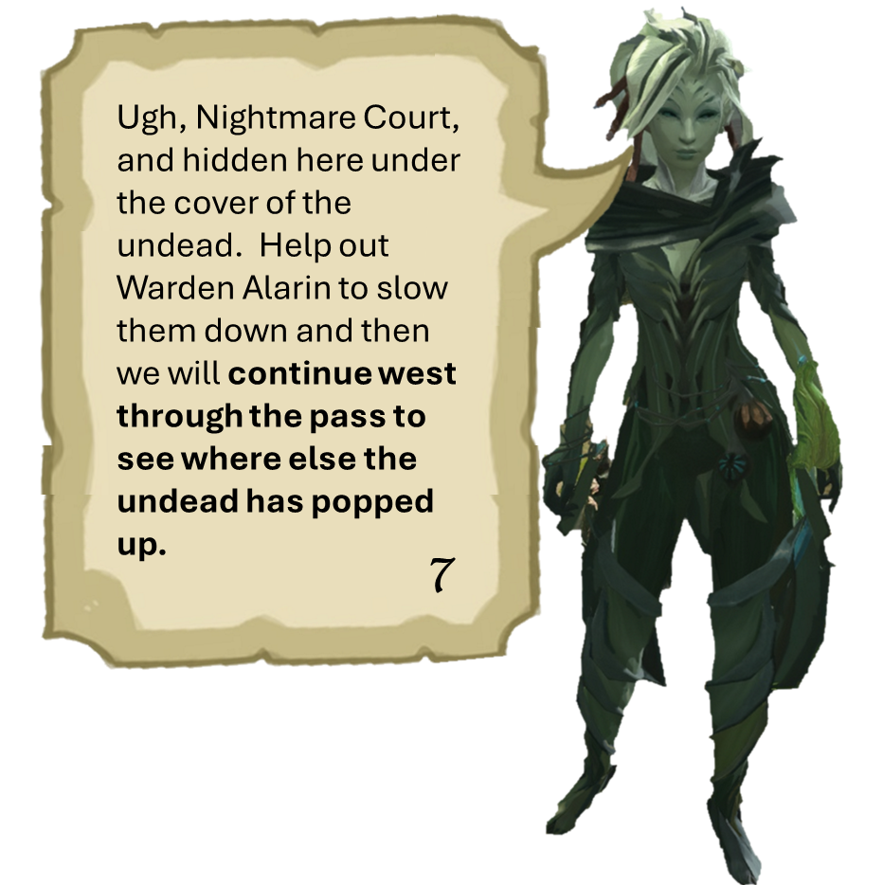
Well look here. Another hidden Nightmare Court base..? No it’s an enclave, a den of nightmares. We will have to figure a way in later…lets keep going to see if there are more undead ahead.
Let’s check on our local tribe of hylek.
Ugh, Nightmare Court, and hidden here under the cover of the undead. Help out Warden Alarin to slow them down and then we will continue west through the pass to see where else the undead has popped up.
8
7

Slide 6
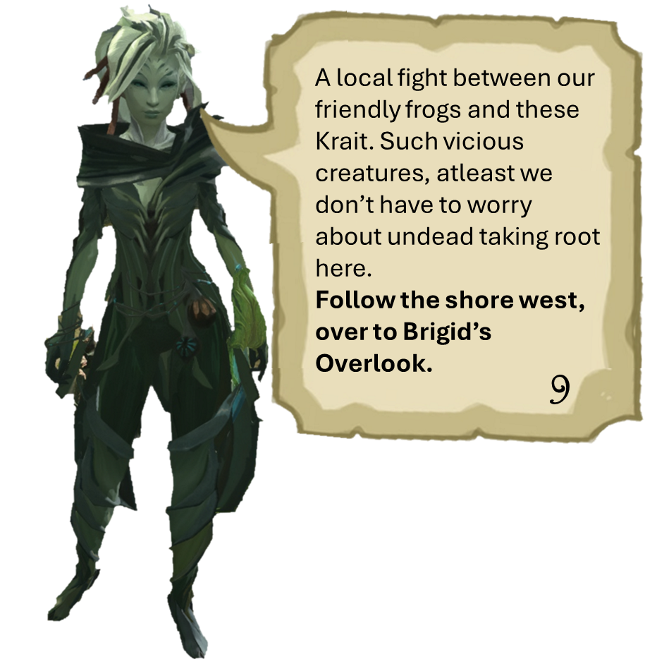
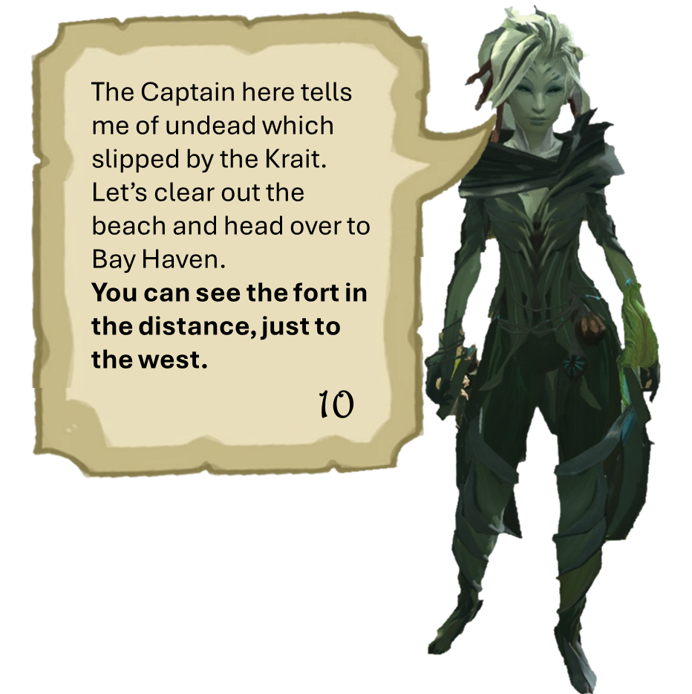
A local fight between our friendly frogs and these Krait. Such vicious creatures, atleast we don’t have to worry about undead taking root here.
Follow the shore west, over to Brigid’s Overlook.
The Captain here tells me of undead which slipped by the Krait. Let’s clear out the beach and head over to Bay Haven.
You can see the fort in the distance, just to the west.
9
10

Slide 7
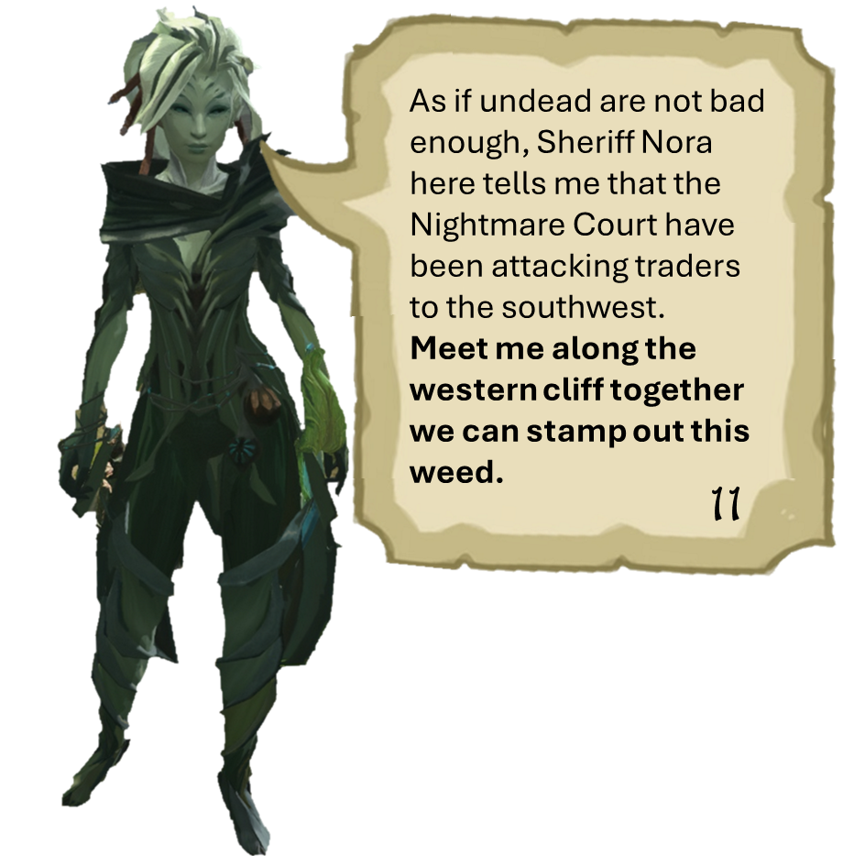
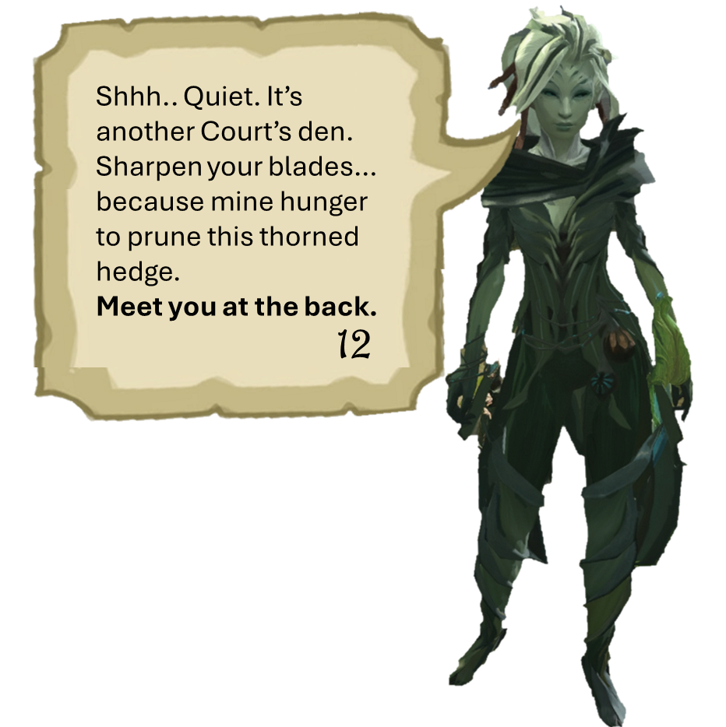
As if undead are not bad enough, Sheriff Nora here tells me that the Nightmare Court have been attacking traders to the southwest.
Meet me along the western cliff together we can stamp out this weed.
Shhh.. Quiet. It’s another Court’s den. Sharpen your blades… because mine hunger to prune this thorned hedge.
Meet you at the back.
12
11

Slide 8
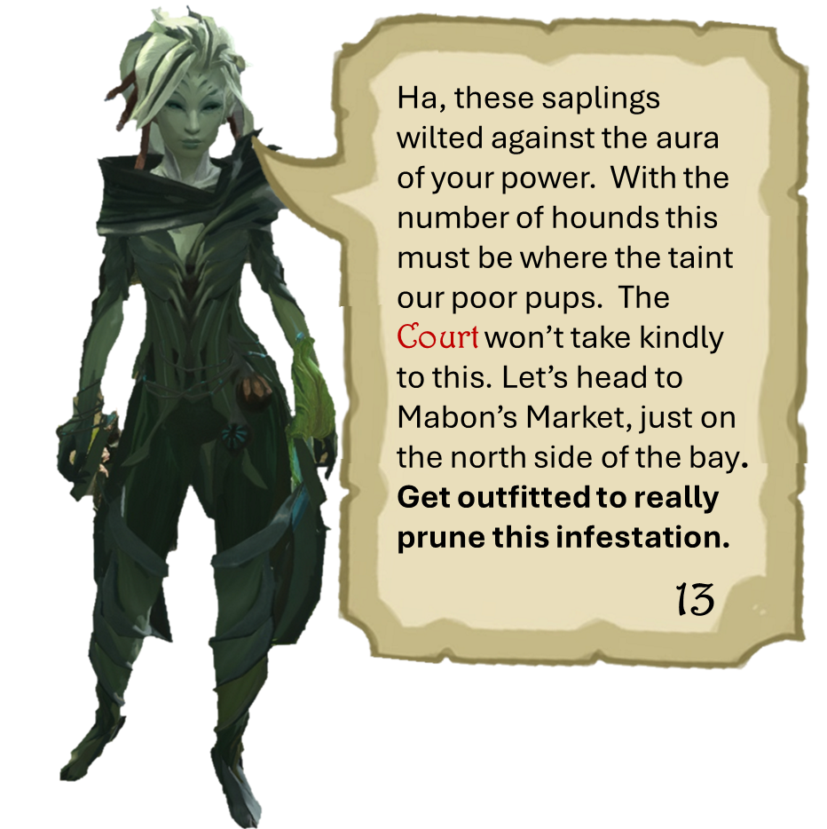
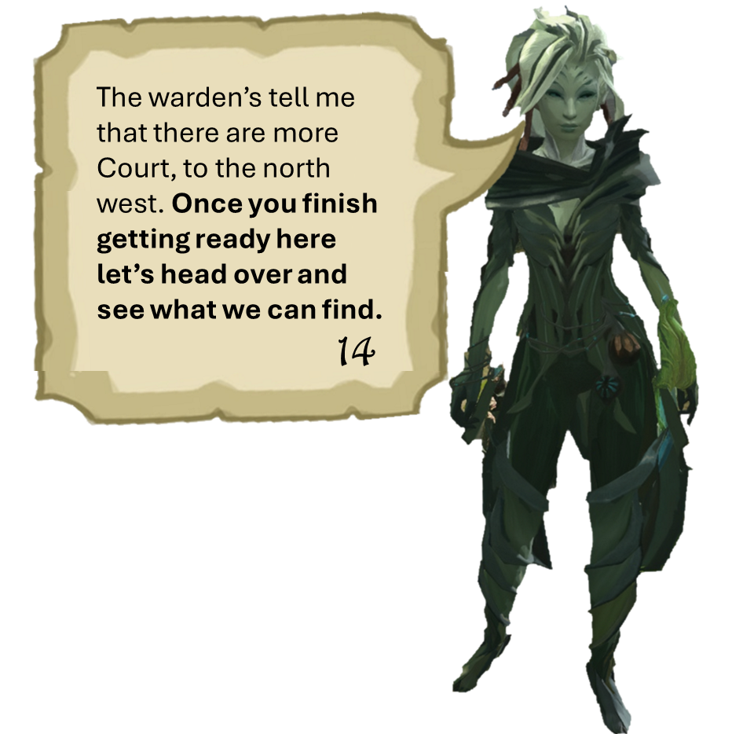
Ha, these saplings wilted against the aura of your power. With the number of hounds this must be where the taint our poor pups. The Court won’t take kindly to this. Let’s head to Mabon’s Market, just on the north side of the bay.
Get outfitted to really prune this infestation.
The warden’s tell me that there are more Court, to the north west. Once you finish getting ready here let’s head over and see what we can find.
14
13

Slide 9
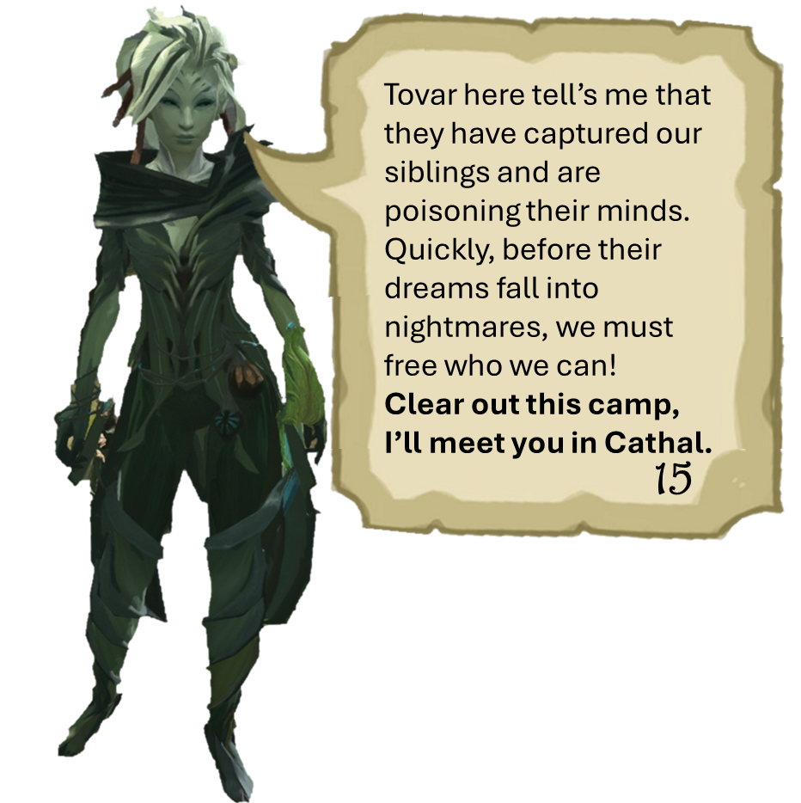
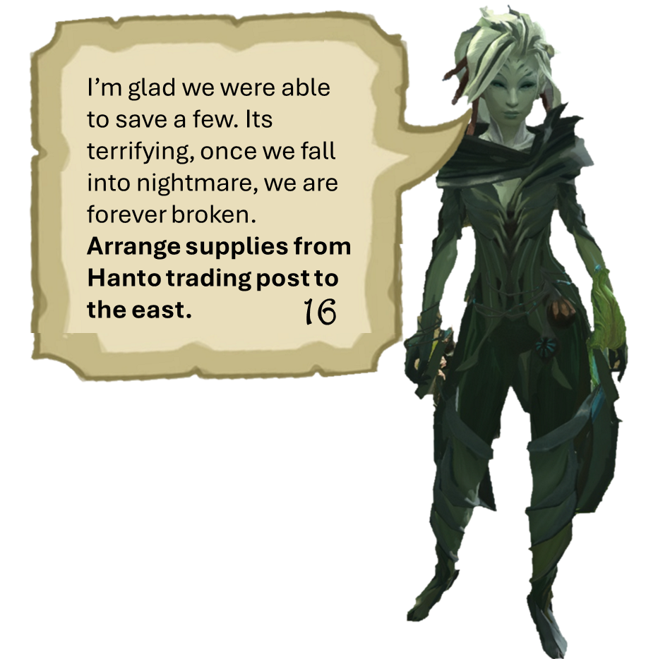
Tovar here tell’s me that they have captured our siblings and are poisoning their minds. Quickly, before their dreams fall into nightmares, we must free who we can!
Clear out this camp, I’ll meet you in Cathal.
I’m glad we were able to save a few. Its terrifying, once we fall into nightmare, we are forever broken.
Arrange supplies from Hanto trading post to the east.
16
15

Slide 10
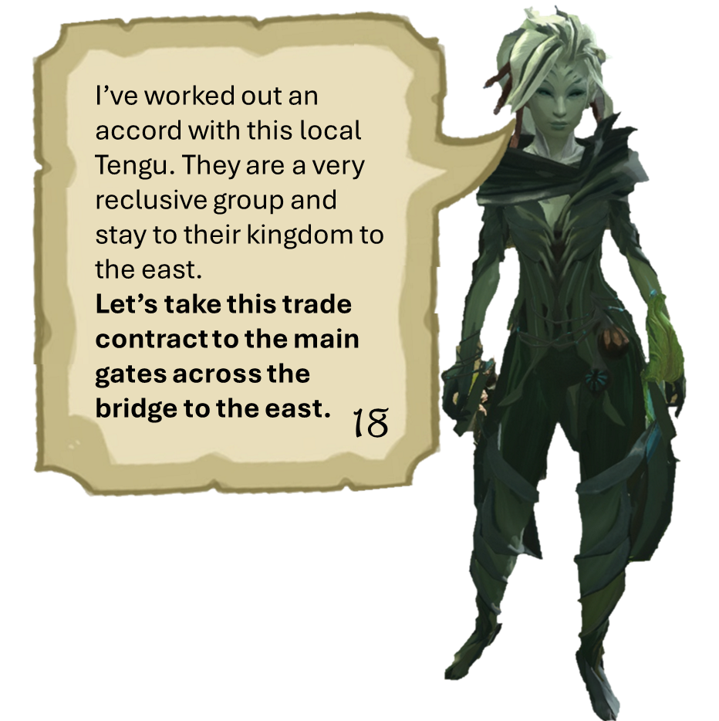

I’ve worked out an accord with this local Tengu. They are a very reclusive group and stay to their kingdom to the east.
Let’s take this trade contract to the main gates across the bridge to the east.
I’ve worked out an accord with this local Tengu. They are a very reclusive group and stay to their kingdom to the east.
Let’s take this trade contract to the main gates across the bridge to the east.
17
18

Slide 11

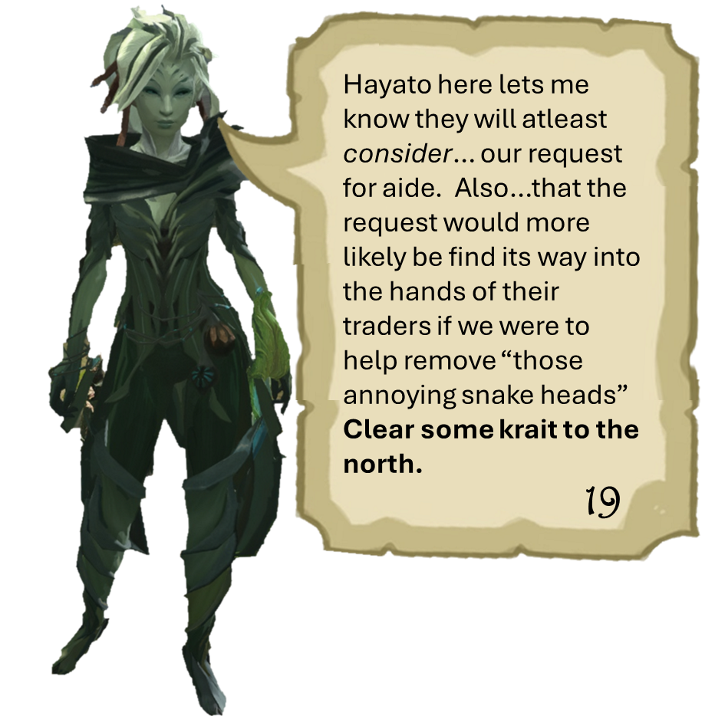
Hayato here lets me know they will atleast consider… our request for aide. Also…that the request would more likely be find its way into the hands of their traders if we were to help remove “those annoying snake heads”
Clear some krait to the north.
They’re so…. “cute”, I think is what I shall report back about these Quaggan. No krait yet, but they reported being harassed by them further north.
Let’s keep going and see if we can satisfy our Tengu neighbors.
19
20

Slide 12
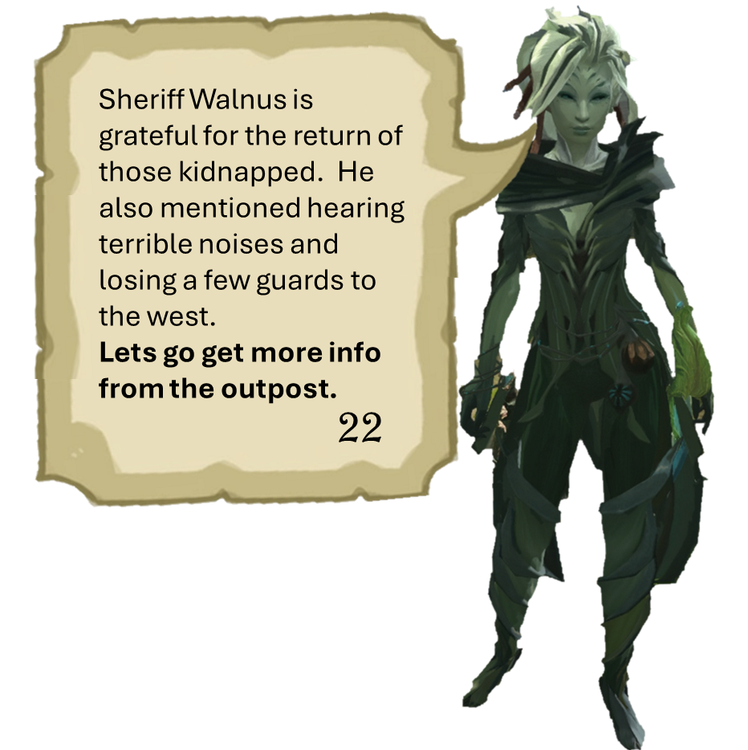
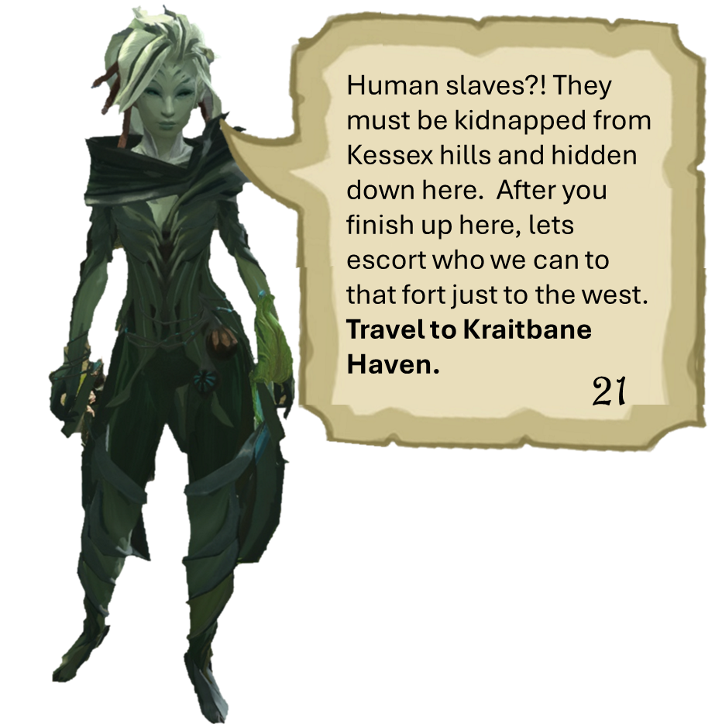
Human slaves?! They must be kidnapped from Kessex hills and hidden down here. After you finish up here, lets escort who we can to that fort just to the west.
Travel to Kraitbane Haven.
Sheriff Walnus is grateful for the return of those kidnapped. He also mentioned hearing terrible noises and losing a few guards to the west.
Lets go get more info from the outpost.
21
22

Slide 13
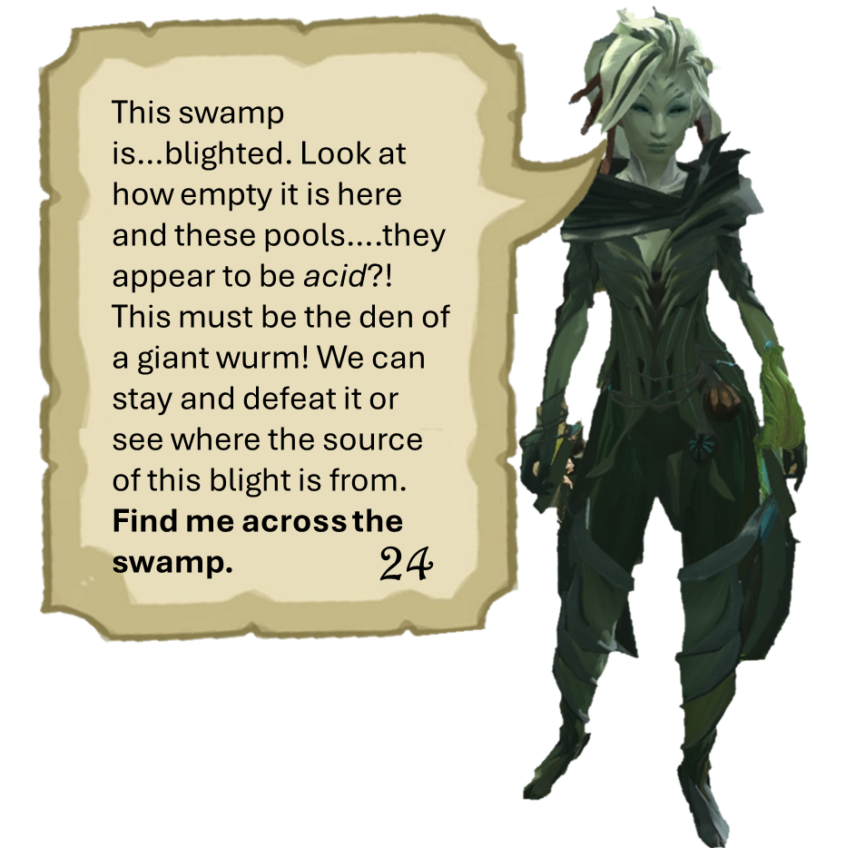
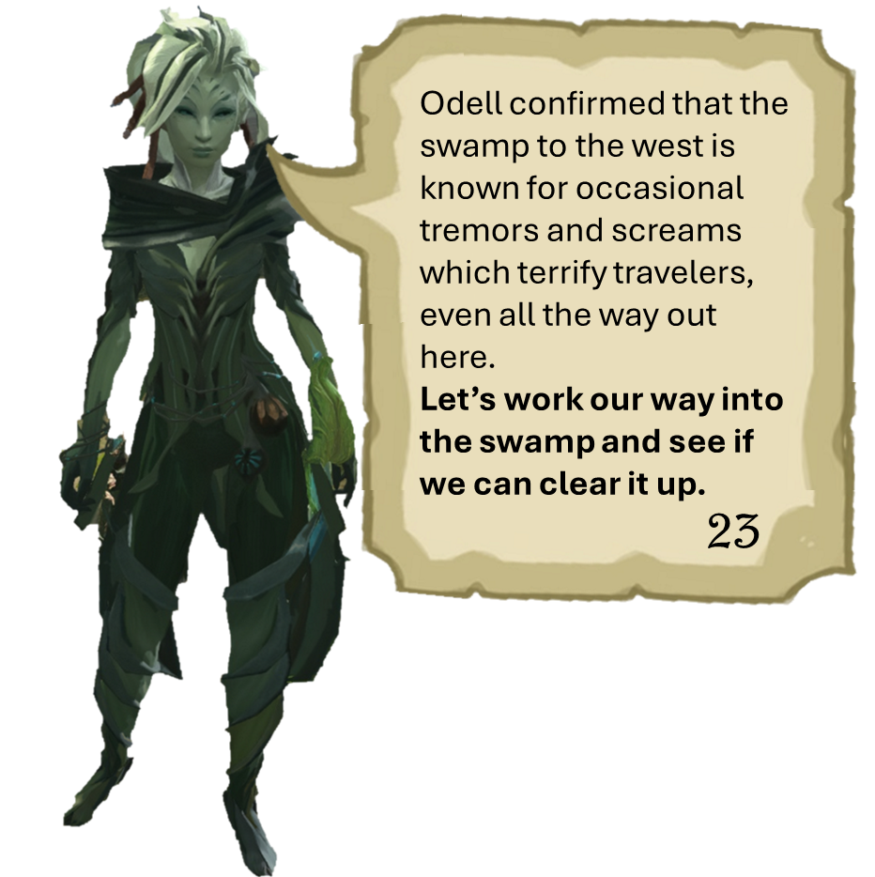
Odell confirmed that the swamp to the west is known for occasional tremors and screams which terrify travelers, even all the way out here.
Let’s work our way into the swamp and see if we can clear it up.
This swamp is…blighted. Look at how empty it is here and these pools….they appear to be acid?! This must be the den of a giant wurm! We can stay and defeat it or see where the source of this blight is from.
Find me across the swamp.
23
24

Slide 14
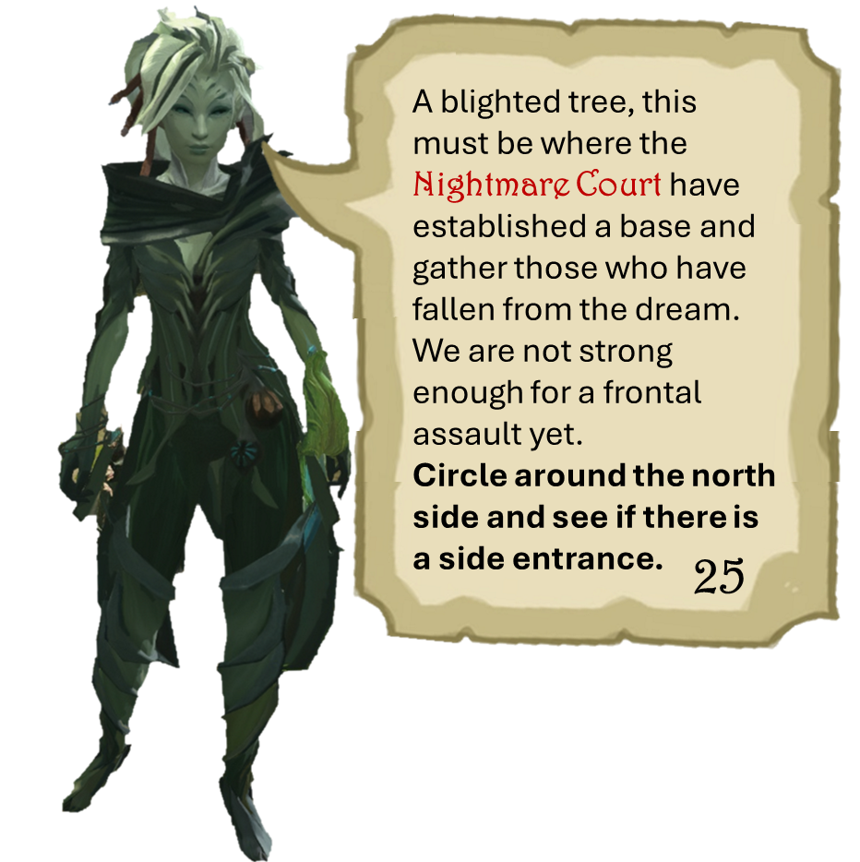
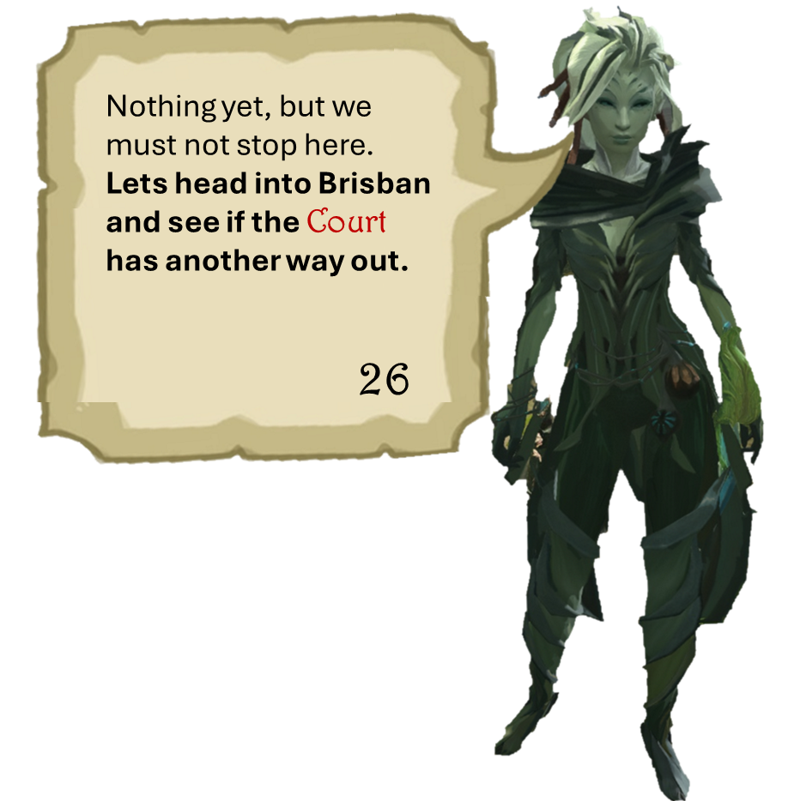
A blighted tree, this must be where the Nightmare Court have established a base and gather those who have fallen from the dream. We are not strong enough for a frontal assault yet.
Circle around the north side and see if there is a side entrance.
Nothing yet, but we must not stop here. Lets head into Brisban and see if the Court has another way out.
26
25

Slide 15
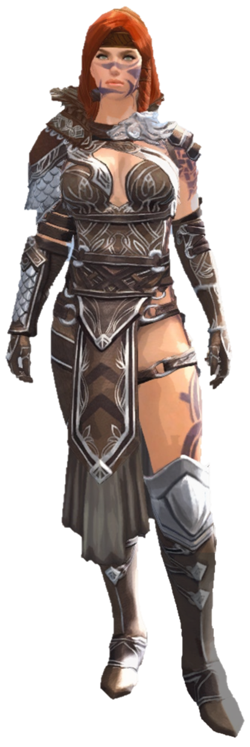

Slide 16
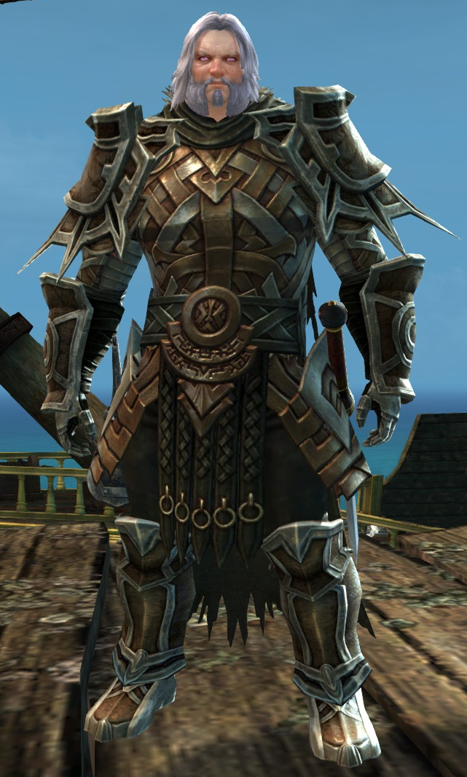
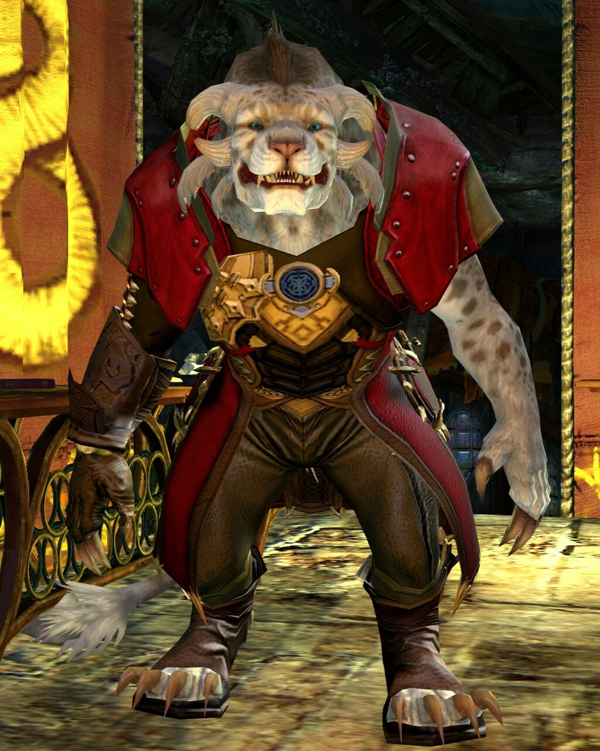
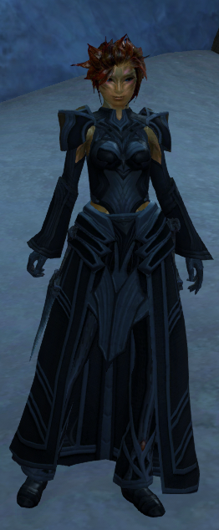

Slide 17
